Slide 1
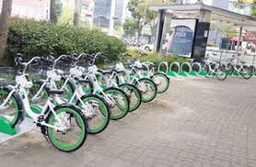
On Job training (INTERNSHIP) PROJRCT PRESENTATION
Bike Sharing Demand Prediction

Slide 2

PRESENTED BY:- CHAITALI KATE ANKITA KENJALE SNEHA BIRNALE DNYANESHWARI JADHAV TULJARAM CHATURCHAND COLLEGE OF ARTS,SCIENCE AND COMMERCE,baramati
INTERNAL GUIDE
Mr..Prajyot Patil
Founder and CEO of AIS Solutions.Pvt.Ltd

Slide 3





HOME
OBJECTIVES
EDA
MODEL BUILDING
CONCLUSION

Slide 4


INTRODUCTION ABOUT THE TOPIC
The data is taken from Souel City of South Korea.Currently Rental bikes are introduced in many urban cities for the enhancement of mobility comfort. It is important to make the rental bike available and accessible to the public at the right time as it lessens the waiting time.
Eventually, providing the city with a stable supply of rental bikes becomes a major concern. The crucial part is the prediction of bike count required at each hour for the stable supply of rental bikes.

Slide 5

OBJECTIVES :
To identify and evaluate the seasonal fluctuations in the demand for rental bike.
Investigate the variations in bike rental demand across different hours per day and days of the month and to identify the peak demand periods.
To identify which features in dataset have the most significant impact on target outcome
To determine which model is best suited for bike sharing demand dataset.
To identify relationships between variables to understand how different factor influence the demand for rental bikes

Slide 6

EXPLORATORY DATA ANALYSIS
Seasonable fluctuations with respect to other factors
Daywise,monthwise and hours per day demand
Influence of Holiday conditions
Influence of weather conditions

Slide 7
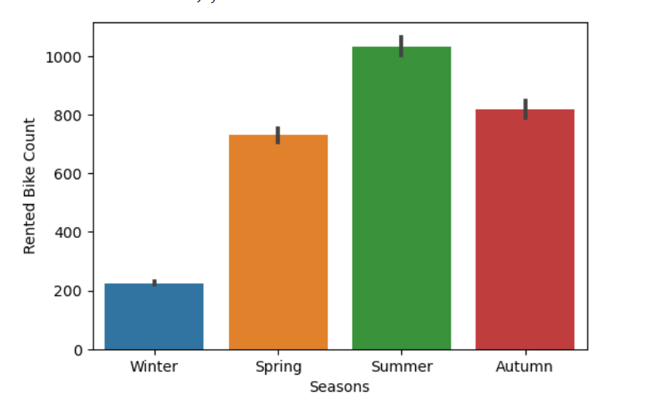
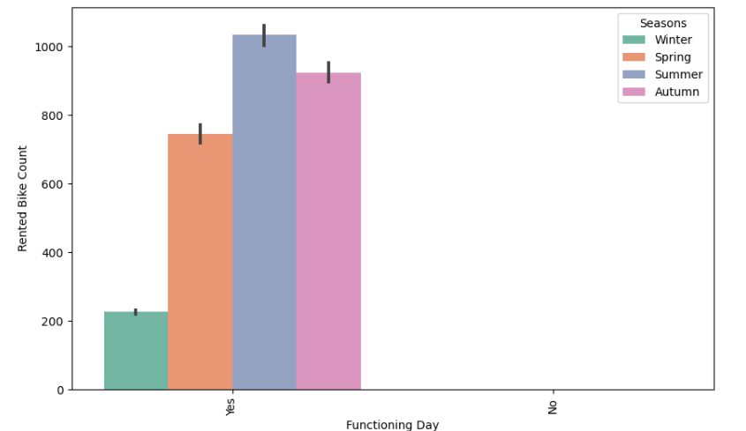
Summer seasons has on an average maximum demand for rental bikes as compared to other seasons whereas winter as lowest
There is not all demand for the rental bikes on non functioning days,In summer the demad is more followed by Autumn.Spring and Winter respectively.

Slide 8
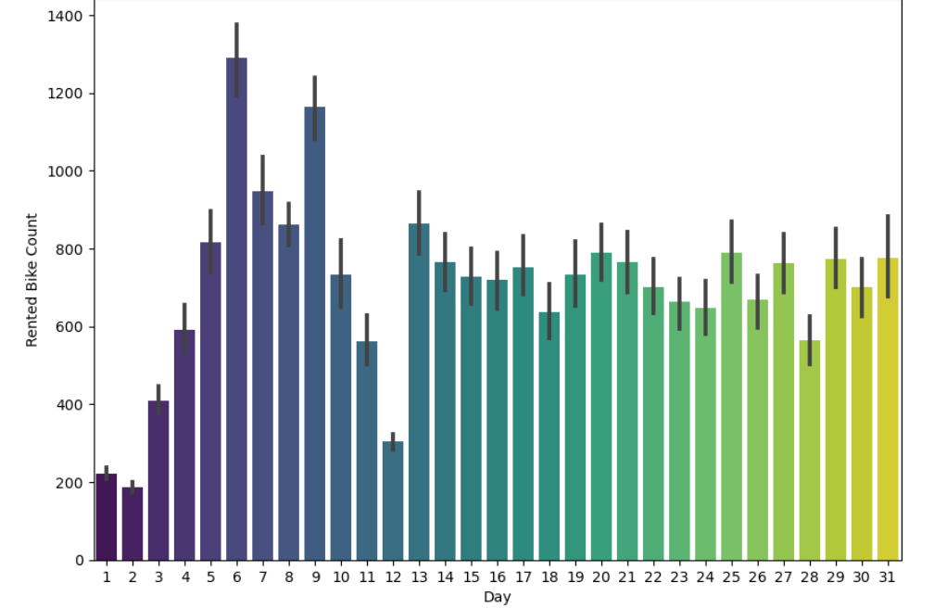
[66]:
6th day of month has highest number of rented count followed by the 7th,9th and 13th day respectively.whereas the 1st,2nd,and 12th day has lowest number of rented bikes.

Slide 9
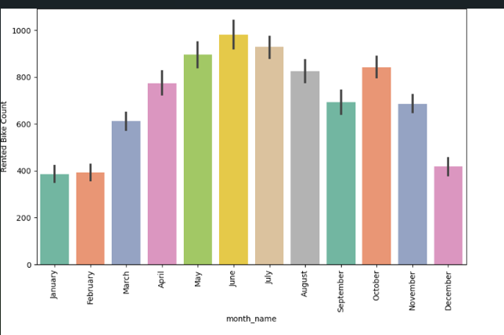
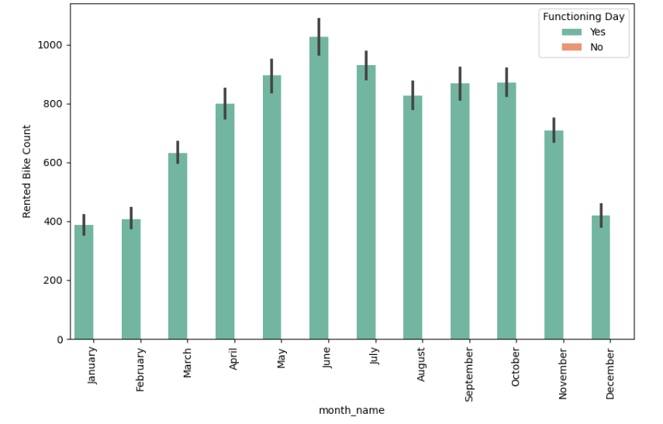
May,June,July have high number of rental bikes whereas January,February and December month has low number of rental bikes.
On non functioning day there is not at all demand for the rental bikes whereas in june on functioning day there is more demand of rental bikes.

Slide 10
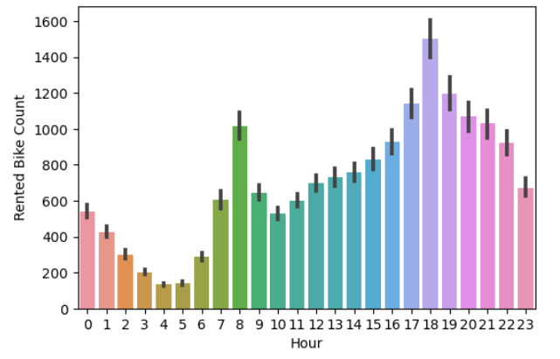
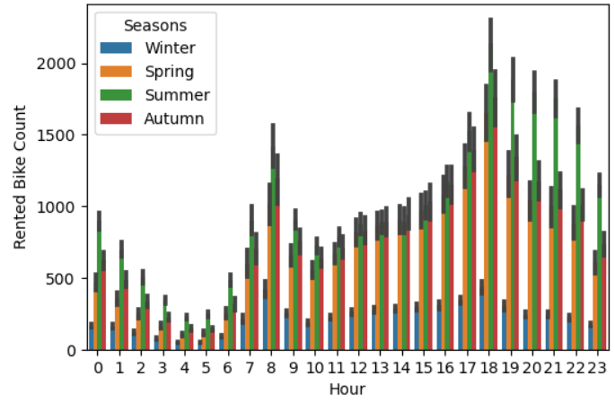
On an average the demand for rental bikes is high for 18 hours while demand is less for for 4 hours
In summer season the average number of demand of rental bikes is high on all the hours but it is relatively more on 8,17,18,19,20,21 hours.

Slide 11
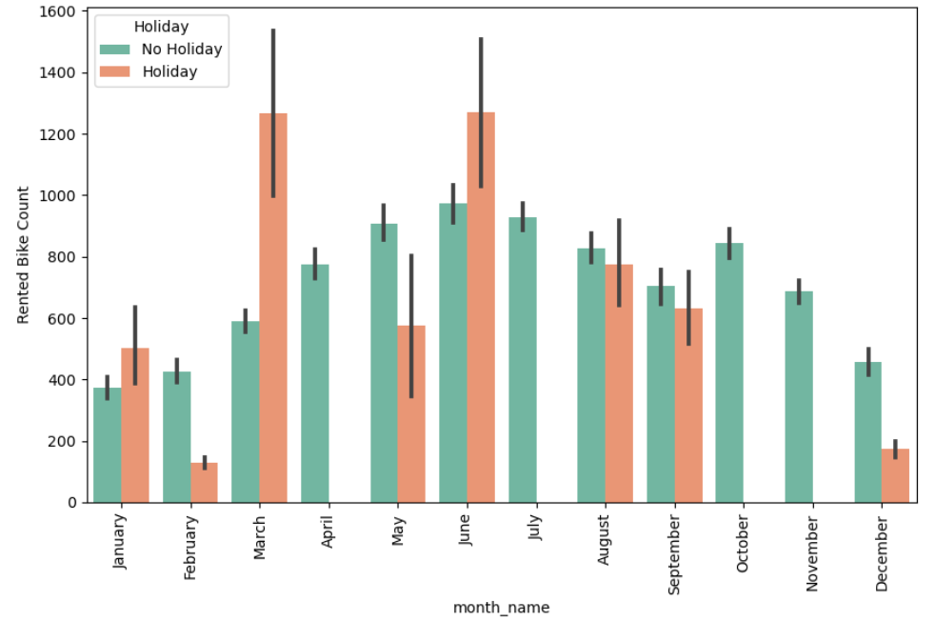
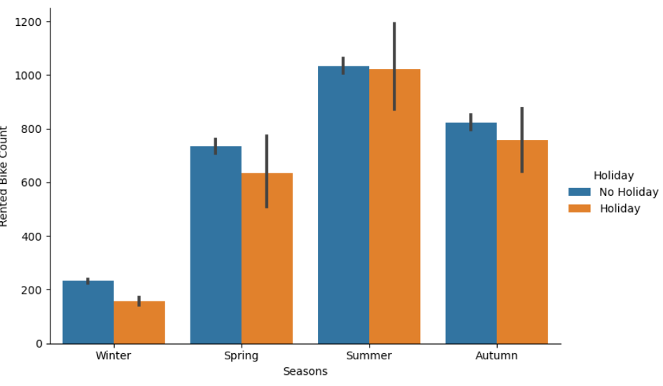
In june and march ,the demand of rental bikes on an average is more.Thus june has maximum demand but also in the month of march the average count of rental bikes is more.In the months like April,July,october and november there is no demand for the bikes on holidays
In Summer Season,the demand for rental bikes on an average is high on holidays as well as non holidays,followed by Autumn,Spring and winter

Slide 12
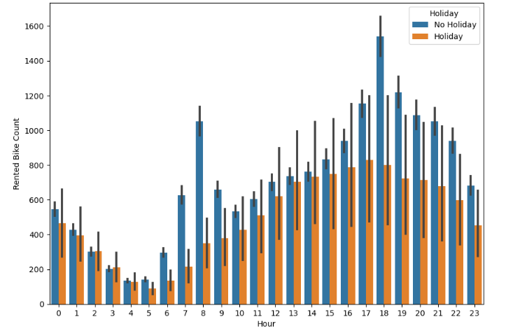
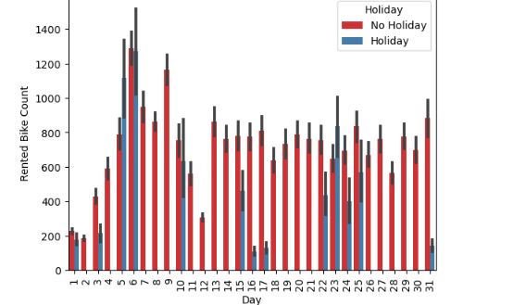
On an average maximum number of bikes are given rented for 18 hours when there is no holiday .In general the demand is more on non holidays,for more time period,there is much demand as compared to short time slot.
On the 6th day of the month,the on an average demand of rental bikes is more whether it be holiday or not.The 2nd, 7th,8th,9th,11th,12th,13th,14th,18,19,20,21st day has rental bike demand only if there is no holiday.On the month-end the demand is more if it is no holiday but is very less if it is holiday

Slide 13
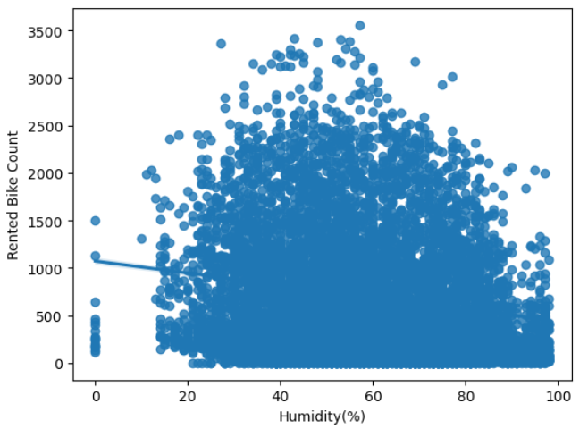
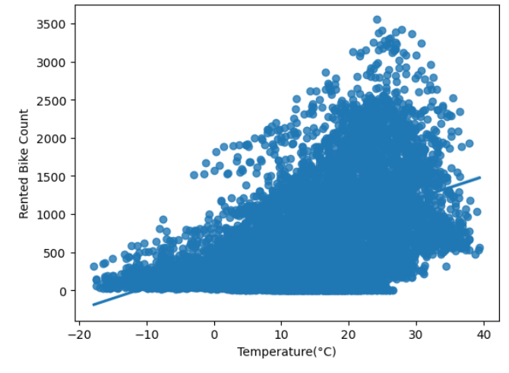
From the scatter plot,we see that when the humidity is normal the demand for rental bikes is more .When the humidity is either low or high the demand decreases
As Temperature increases the demand for Rented Bike Count increases. Thus also when there is normal temperature the demand is high and when it is low the demand is less

Slide 14
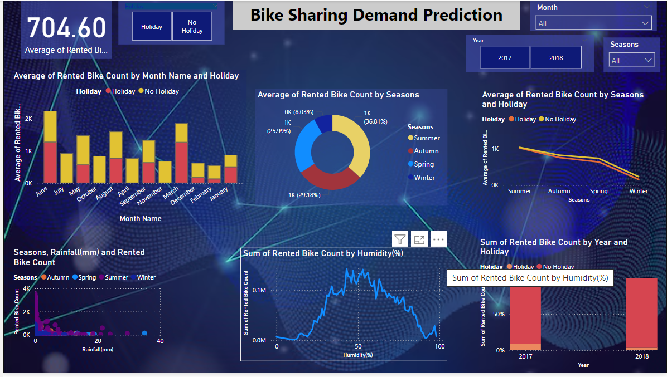

Slide 15

MODEL BUILDING
Train and Test Split:
The initial step in building a machine learning model is to split the data into training and testing sets.
This process ensures that the model is trained on one subset of the data (usually 80%) i.e.training set and evaluated on a different subset (testing set) to assess its performance and generalizability

Slide 16
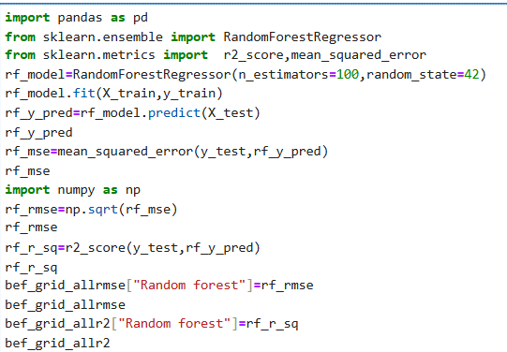
Random Forest Model:
:

Slide 17
Similarly we build other models like :
K-Nearest Neighbors(KNN)
Linear Regression
Ridge Regression
Support Vector Regressor(SVR)
Elastic Net Regressor
Principal component Regression(PCR)
Partial Least Square Regressor(PLSR)
Gradient Boosting Regressor
Decision Tree Regressor

Slide 18
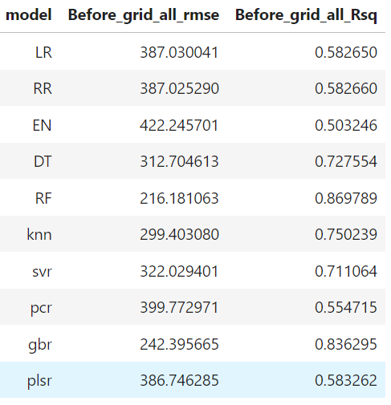
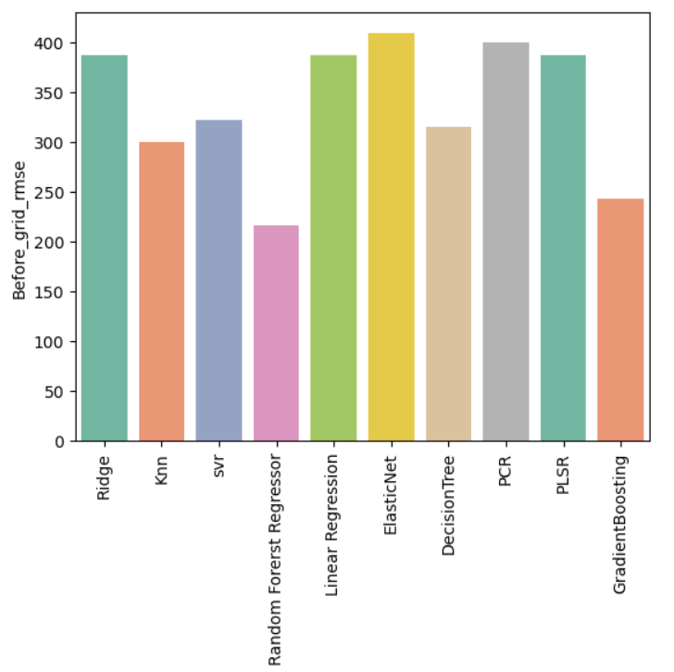
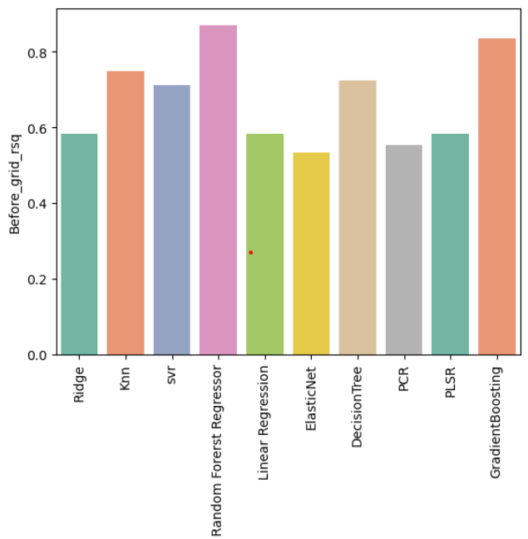
Randon Forest Algorithm is best as compared to other models since its RMSE is less and R_sq is greater

Slide 19
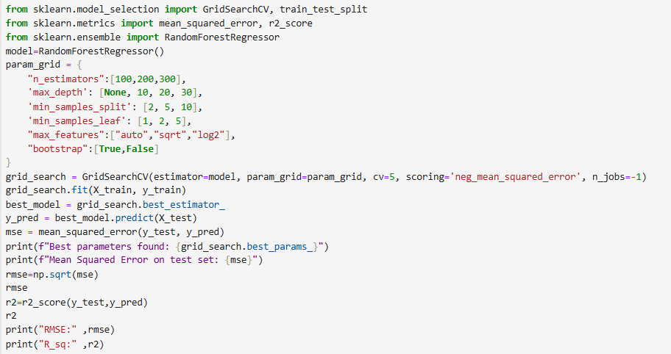
GridSearchCV Code for RandomForest Regressor:
GridSearchCv is a approach to finding the best parameter .

Slide 20
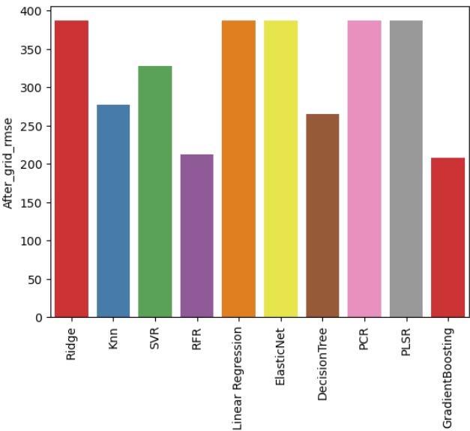
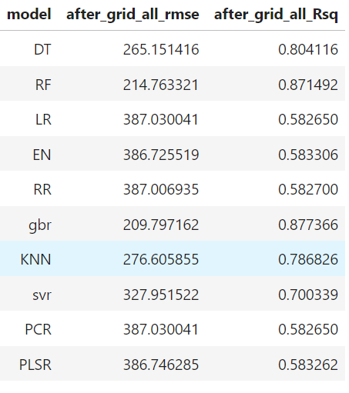
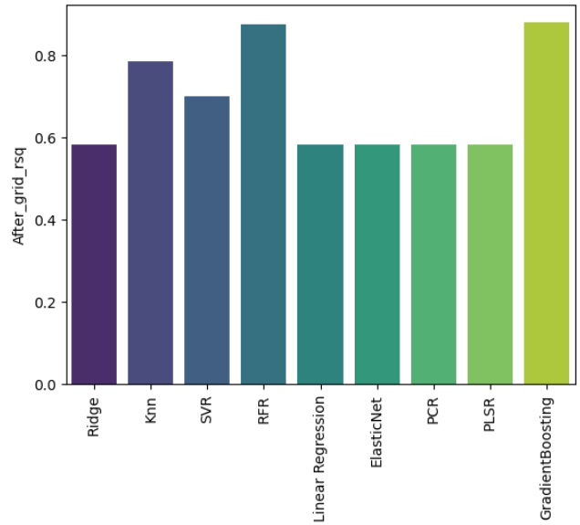
After GridSearchCV, Random Forest and Gradient Boosting models are good

Slide 21
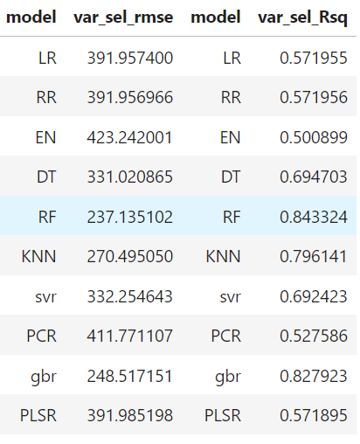
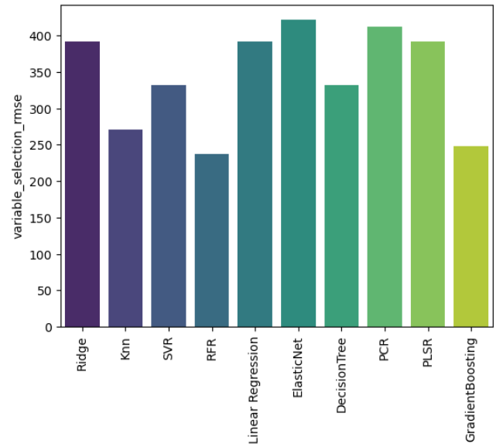
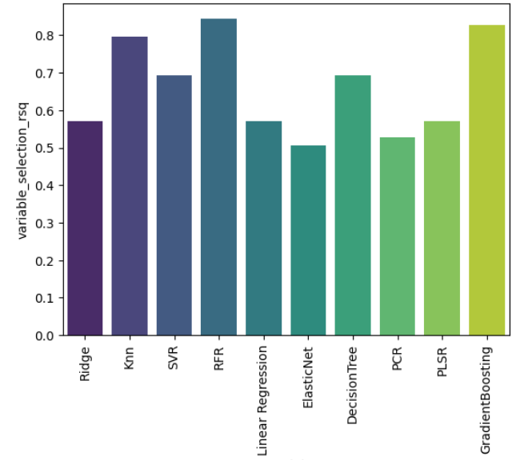
After Feature importance algorithm also Random Forest and Gradient Boosting method are good

Slide 22
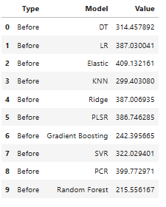
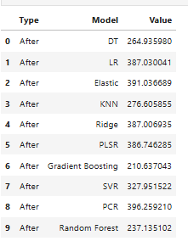
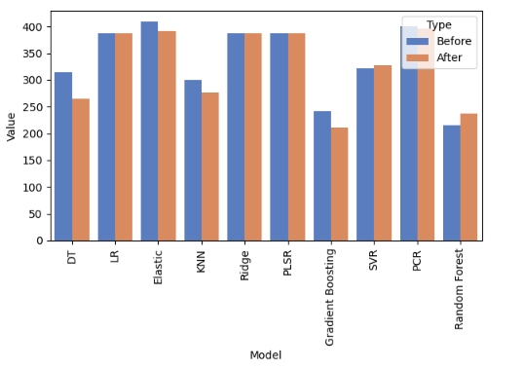
Before GridSearchCV
After GridSearchCV
From the above graph,it is seen that there is no any change in the RMSE’s of models like Linear Regression,Ridge Regression PLSR and PCR.The RMSE of Decision Tree algorithm has reduced after GridSearchCV.Slight changes are observed in the remaining models

Slide 23
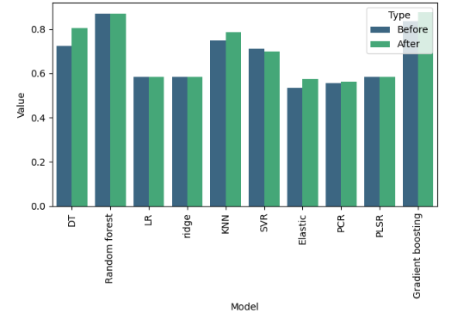
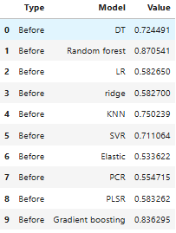
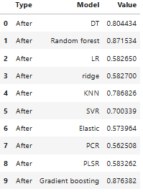
Comaparison of R_sq
Before GridSearchCV
After GridSearchCV
From the above graph,it is seen that there is no any change in the R_sq of models like Linear Regression,Ridge Regression PLSR and PCR.and Random Forest The R_sq of Decision Tree algorithm has increased after GridSearchCV. Slight changes are observed in the remaining models

Slide 24
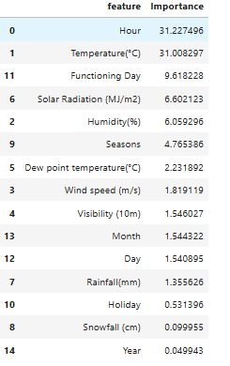
FEATURE IMPORTANCE:
Feature importance in decision trees indicates how influential each feature is in making predictions.
Thus we selected most important features like hour,temperature,functioning day,solar radiation humidity and seasons and build all the models with this data to check the results

Slide 25
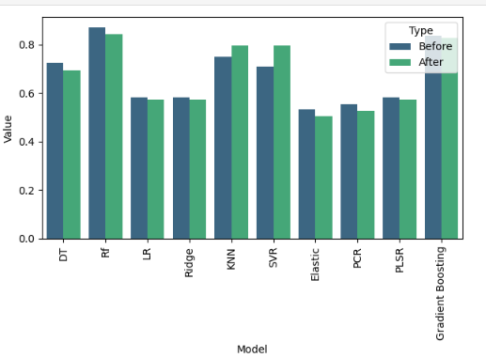
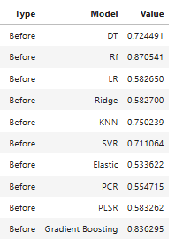
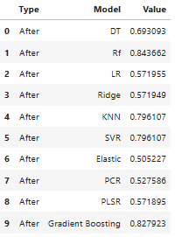
Comparison Of R_sq after Feature Importance
Before Feature Selection
After Feature Selection
The R_sq’s of models like Linear Regression,Ridge regression,PLSR. And Gradient Boosting have not change after feature selection The R_sq of KNN SVR has increased after feature selection.The R_sq of remaing models was high before feature selection

Slide 26
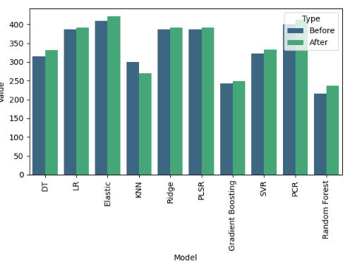
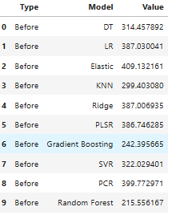
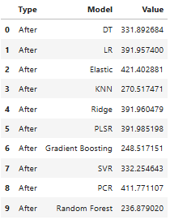
Comparison Of RMSE after Feature Importance
Before Feature Selection
After Feature Selection
The RMSE of KNN is decreased after feature selection.The RMSE of all other models has increased after feature selection Thus Feature selection has impacted the KNN model

Slide 27
CONCLUSIONS AND FINDINGS:
1. Seasonal Trends*: Bike-sharing demand typically varies with the season, with higher usage in warmer months and lower usage in colder months.
2 Weather Impact*: Weather conditions such as temperature, humidity significantly influence bike-sharing demand. Favorable weather conditions usually correlate with increased bike usage.
3 Impact of Holidays*: Holidays tend to disrupt regular usage patterns, often resulting in lower demand.
4 Based on rmse and r square ,the best performing models are random forest and gradient boosting.
5 By feature importance the variables like hour, tempreture, humidity, solar radiation, Functioning day and seasons are important impact on bike sharing demand.

Slide 28

THANK YOU

